Slide 1
26/11/2023
ADVISOR
STUDENT
Aman Gaur(10)
Sagar Rathore(49)
Satyam Sahu(51)
Department of Computer Science, University of Delhi
Dr. Bharti
Horse Survival Prediction using Various Models

Slide 2
Table of
Contents
Page
0
Abstract
3
I
Introduction
4
II
Problem Statement
5
III
Methodology
6
IV
Modelling
16
V
Evaluation
24
VI
Results
26
VI
Conclusion
28
VI
Further Work
28

Slide 3



Abstract
This project proposes a comparative study of different machine learning models (like Random Forest, XGboost, LightGBM, Decision tree and CatBoost) to predict the survival of the horse based on previous medical conditions.
3

Slide 4

I
Introduction
In the field of Data MIning, there are numerous models available, and selecting the most appropriate one for your predictive analysis can be challenging. This project explores several models, including decision trees, random forests, XGBoos, LightGBM and catboost to develop a classifier for predicting horse health status based on their past medical records. We will evaluate the accuracy of each model using unseen data and calculate their respective F1 scores.
4

Slide 5

II
Problem Statement
Develop a predictive model that accurately assesses the survival probability of horses based on their historical medical records. The model should effectively utilize the available data to identify patterns and relationships between medical conditions and survival outcomes. This model can be instrumental in improving equine healthcare and aiding veterinarians in making informed treatment decisions.
5

Slide 6
III
Methodology
The methodology for depends on following phases for prediction of survival of horse.
Data Preprocessing: Getting the dataset, and cleaning the dataset to address missing values, inconsistencies, and outliers. Employ techniques such as imputation, data transformation, and error correction, if needed. And to perform Data Exploration to analyze to understand the distribution of variables, and identify potential patterns.
Feature Engineering: The process of selecting and transforming features. This includes features scaling normalization and encoding categorical attributes.
Model Selection And Training: Evaluate the performance of various machine learning models. Utilize a cross-validation approach to ensure unbiased evaluation.
Model Evaluation: Performance Metrics: Evaluate the final model using metrics such as accuracy, precision, recall, and F1-score on an unseen test dataset. Analyze the errors made by the model to identify potential biases or limitations
6

Slide 7


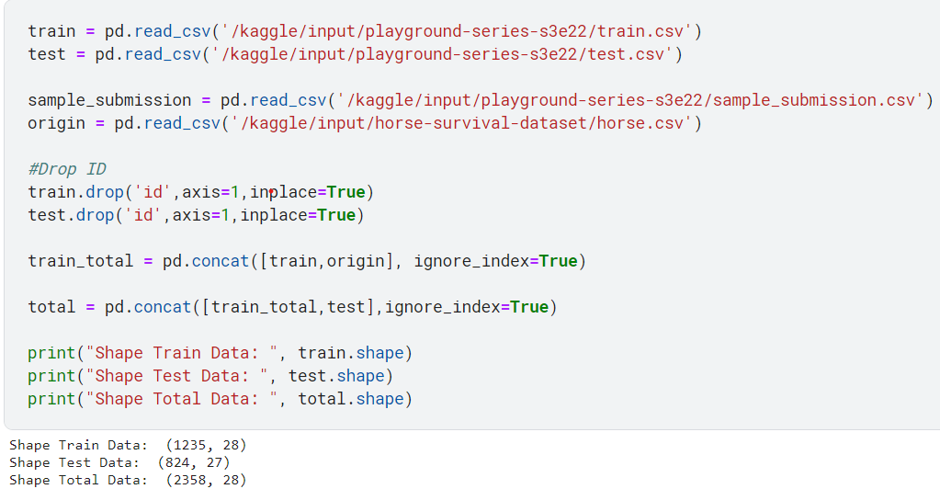
|
Dataset
The dataset “Horse Colic” was picked up from UC Irvine Machine Learning Repository. The dataset is divided into 27 main features and about 300 data objects. the dataset is rich in missing values(about 30 percent) with discrete, nominal, and continuous data types.
7

Slide 8
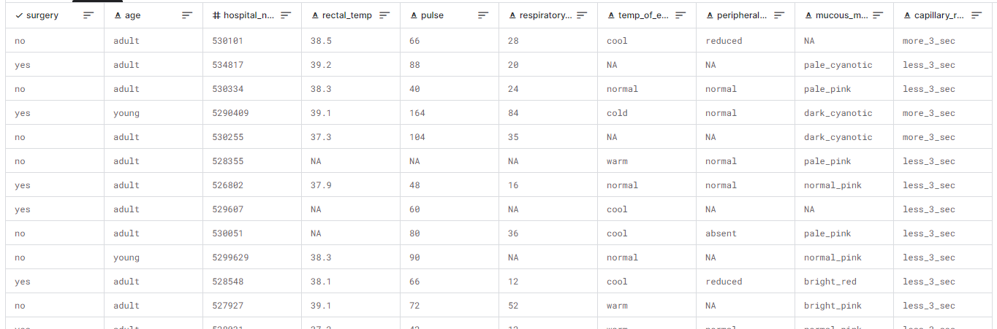
|
Dataset
8

Slide 9
|
Feature Description
To gain a deeper understanding of the dataset, given below are some of its features and their descriptions.
Surgery - Whether the horse was treated with surgery or not.
Age - Age of the horse (young mean <6 months).
Hospital_Number - The case number assigned to the horse (may not be unique if the horse is treated >1 time).
Rectal_Temp - The normal temperature is 37.8 (Celcius degrees) and will usually change as the problem progresses. It may start out normal, then become elevated because of the lesion, passing back through the normal range as the horse goes into shock.
Pulse - Heart rate in beats per minute. This reflects the heart condition: 30 - 40 is normal for adult horses. It's rare to have a lower-than-normal rate, although athletic horses may have a rate of 20 - 25. Animals with painful lesions or suffering from circulatory shock may have an elevated heart rate.
Respiratory_Rate - The normal rate is 88 to 10 and usefulness is doubtful due to the great fluctuations.
9

Slide 10
|
Data Preprocessing
Data preparation is the crucial step of cleaning, transforming, and enriching raw data before it can be used for analysis or modeling. It involves identifying and correcting errors, inconsistencies, and missing values, as well as standardizing data formats and structures.
Attribute | Values
surgery? | 1 = Yes, 2 = No
Age | 1 = Adult, 2 = Young (< 6 months)
temperature of extremities | 1 = Normal, 2 = Warm, 3 = Cool, 4 = Cold
peripheral pulse | 1 = Normal, 2 = Increased, 3 = Reduced, 4 = Absent
capillary refill time | 1 = < 3 seconds, 2 = >= 3 seconds
pain | 1 = no pain, 2 = depressed, 3 = intermittent mild pain, 4 = intermittent severe pain, 5 = continuous severe pain
abdominal distention | 1 = none, 2 = slight, 3 = moderate, 4 = severe
nasogastric tube | 1 = none, 2 = slight, 3 = significant
nasogastric_reflux | 1 = none, 2 = > 1 liter, 3 = < 1 liter
In order to train our machine learning model effectively, we need to transform the categorical features in our dataset into numerical data, this process is called encoding.
10

Slide 11
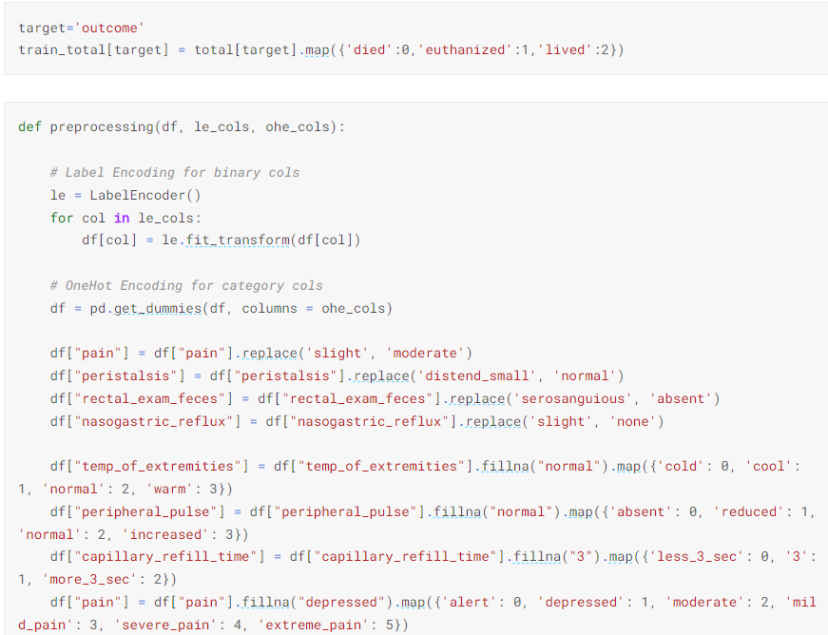
|
Data Preprocessing
11

Slide 12
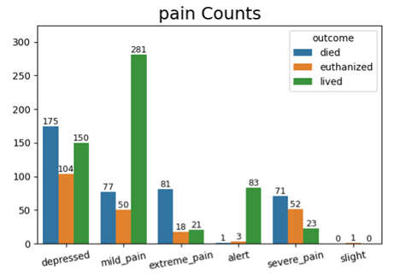
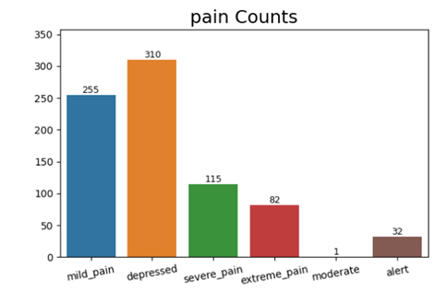
|
Data Preprocessing
The are 3 types of Encoding:
One hot Encoding : with one-hot, we convert each categorical value into a new categorical column and assign a binary value of 1 or 0 to those columns
Ordinal Encoding. We assign an index to a categorical value in the categorical column.
We found out that ordinal encoding gave better results than one hot encoding in this case.
12

Slide 13
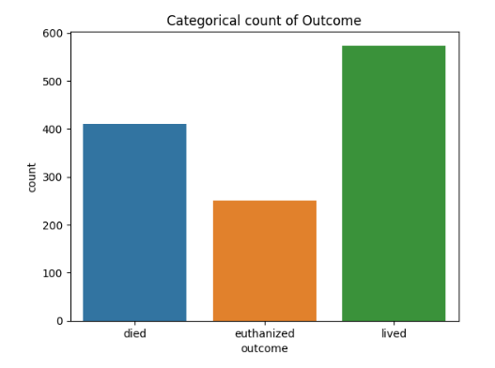
|
Data Visualization
After data cleaning, we plot some graphs for a better understanding of data patterns to get new insight of the structure of the data.
Given a graph of the target variable ‘outcome’ to show it’s distribution.
13

Slide 14
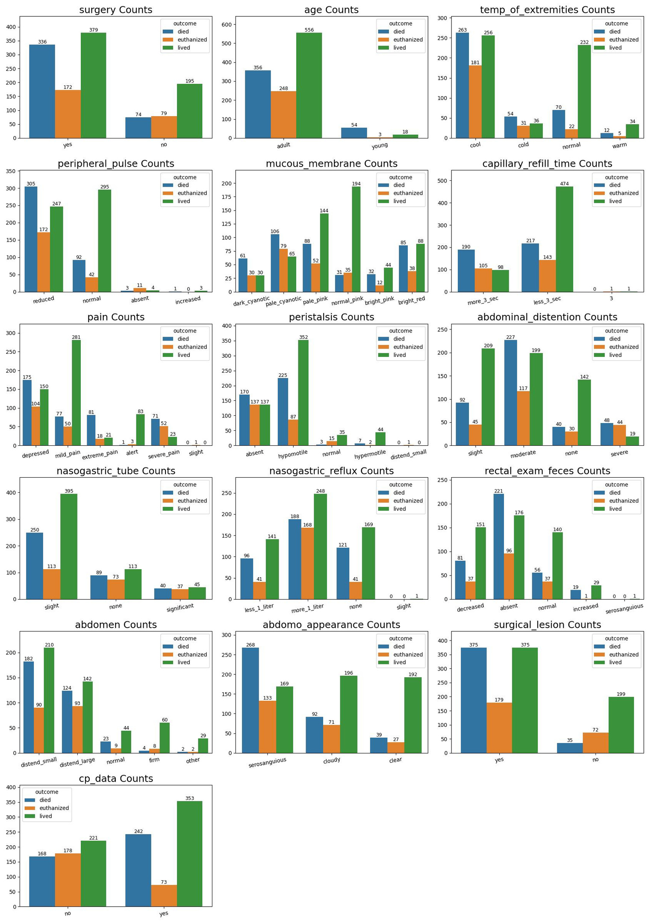
Count plot for some categorical feature’s distribution in train data
Some insights
lesion_2 Counts and lesion_3 Counts appear to have similar distributions. When they are not 0, the horse has a high probability of not dying.
When cp_data_Counts is Yes, the target variable is euthanized with a small probability
14

Slide 15
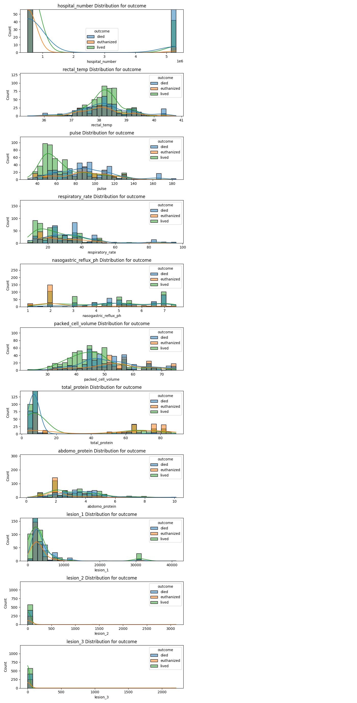
Distribution of some Numerical Features
15

Slide 16
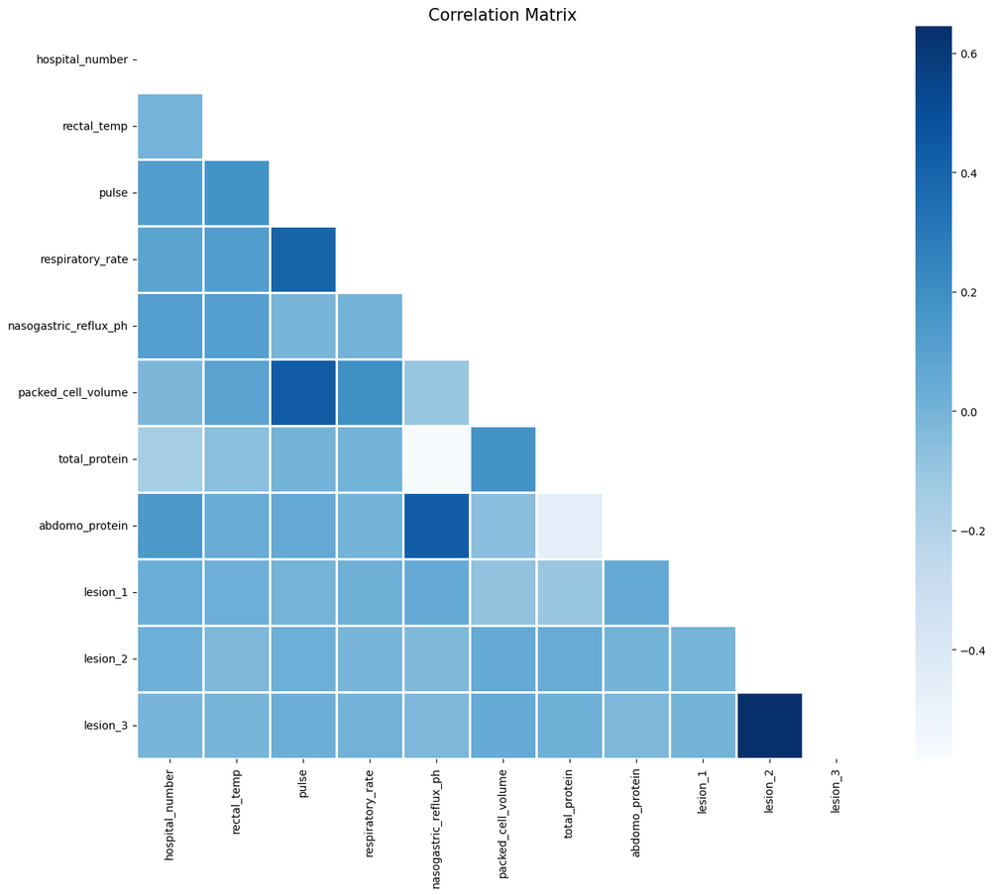
Correlation Matrix
Correlation matrix of numerical features.
16

Slide 17
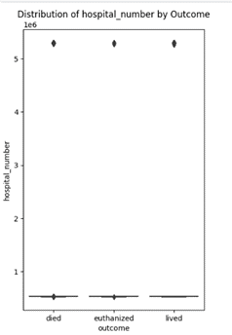
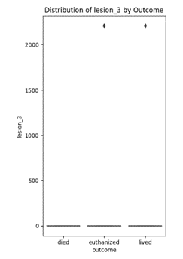
|
Feature Engineering
To enhance the model's performance, we made several adjustments to the dataset:
Feature modification: Due to only one instance of "slight" pain in the training dataset and "moderate" pain in the test dataset, we merged them into one. Similarly, there are many instances like this in datasets like peristalsis, rectal_exam_feces, and nasogastric_reflux.
Missing Values: To address the missing values in categorical features, we filled them with their mode.
Dropped Feature: Based on boxplot analysis, we identified that the features "hospital_number" and "lesion 3" did not effectively differentiate between classes. Consequently, we removed these features from the training dataset.
17

Slide 18
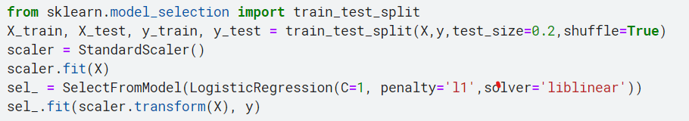
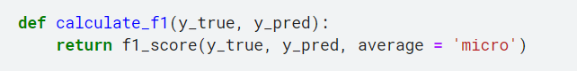
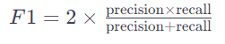
|
Train Test Split
splitting a dataset into training and testing sets using train_test_split, scaling the features using StandardScaler, and then applying feature selection using SelectFromModel with a LogisticRegression model.
|
F1-Score Function
used to evaluate a model's performance
18

Slide 19
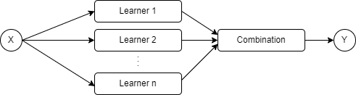
IV
Modelling
Models are essential tools in data mining for classification tasks. They allow us to learn patterns from data and use those patterns to make predictions about new data points
Ensemble Learning
Ensemble learning is a supervised learning technique that combines multiple models to build a more powerful and robust model and then to combine their predictions for the classification of unseen instances using some form of voting (such as majority voting…).
19

Slide 20
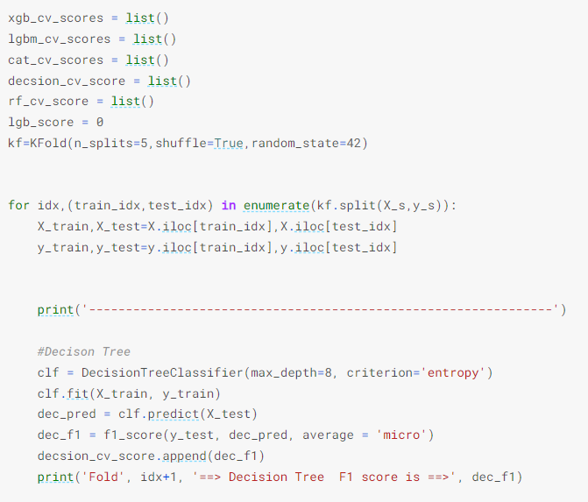
|
K-Fold Cross-Validation
K-Fold is a popular method used for assessing the performance of a machine learning model.
It involves splitting the dataset into K subsets or "folds" of approximately equal size.
The model is trained and evaluated K times, using a different fold as the test set each time while the remaining folds are used for training.
20

Slide 21
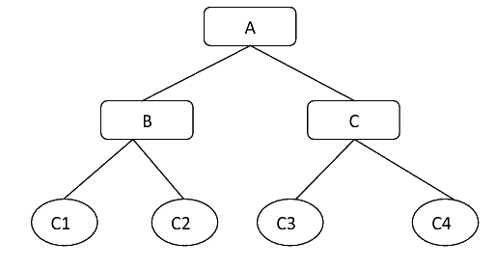
i. Decision Tree
Decision trees are used to solve classification problems and categorize objects depending on their learning features. They can also be used for regression problems or as a method to predict continuous outcomes from unforeseen data. The decision tree algorithm belongs to the supervised learning algorithm family.
21

Slide 22
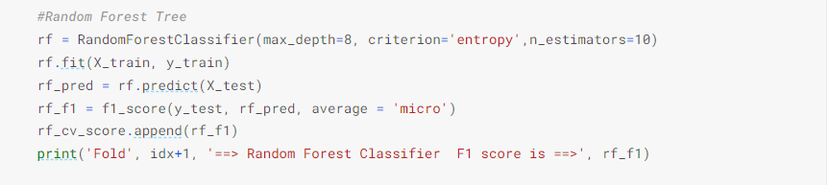
ii. Random Forest
A random forest model is a extension of bagging technique that combines multiple decision trees to create a more accurate and robust prediction. It works by selecting random subsets of the data and features, also known as feature bagging, generates a random subset of features, which ensures low correlation among decision trees, and building a decision tree for each subset. Then, it aggregates the predictions of all the trees to produce the final output
22

Slide 23
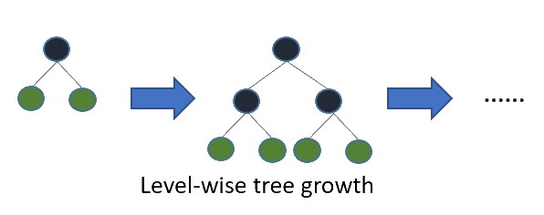
iii. Extreme Gradient Boosting
In XGBoost decision trees are created in sequential form. Weights are assigned to all the independent variables which are then fed into the decision tree which predicts results. The weight of variables predicted wrong by the tree is increased and these variables are then fed to the second decision tree. Each decision tree is trained on a random subset of the data and features, and tries to minimize the loss function. These individual classifiers/predictors then ensemble to give a strong and more precise model. It can work on regression, classification, ranking, and user-defined prediction problems.
23

Slide 24
Used Parameters
'objective': 'multi:softmax': This parameter specifies the learning task and the objective function to be used. In this case, it's set to 'multi:softmax', indicating that the model is configured for multi-class classification.
'num_class': 3: This parameter defines the number of classes in the classification task.
'max_depth': 10:Maximum depth of a tree. Increasing this value will make the model more complex and more likely to overfit
'learning_rate': 0.1: This parameter determines the step size at each iteration while moving towards a minimum of the loss function. It scales the contribution of each tree. A lower learning rate typically requires more trees in the ensemble but can lead to better generalization.
24

Slide 25
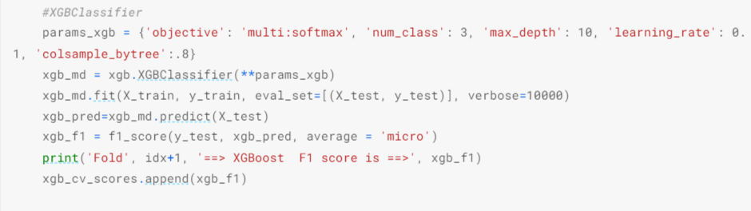
iii. Extreme Gradient Boosting
25

Slide 26
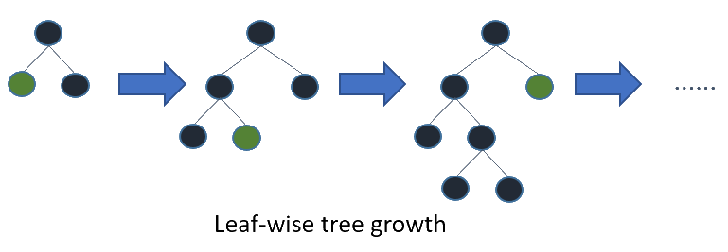
iv. Light Gradient Boosting Model
LGBM model is a gradient boosting technique that uses decision trees as weak learners and improves their performance by adjusting their weights based on the error of the previous learner. LGBM model has several features that make it faster and more accurate than other gradient boosting algorithms, such as histogram-based algorithm, leaf-wise growth, exclusive feature bundling, and parallel and distributed learning.
26

Slide 27
Used Parameters
'n_estimators':number of boosting iterations
'max_depth': limit the max depth for tree model.
'learning_rate': shrinkage rate, Lower learning rates generally lead to more robust models by making the model learning more conservative.
'subsample': Specifies the fraction of samples (observations) to be used for training each individual tree. Setting it to 0.20 means only 20% of the data will be randomly sampled for each tree, which can help prevent overfitting by introducing randomness.
'colsample_bytree': Determines the fraction of features (columns) to be randomly selected for each tree. This value of 0.56 means that 56% of the features will be used for building each tree, introducing diversity among the trees.
'reg_alpha': This parameter represents regularization terms that penalize the complexity of the model.
27

Slide 28
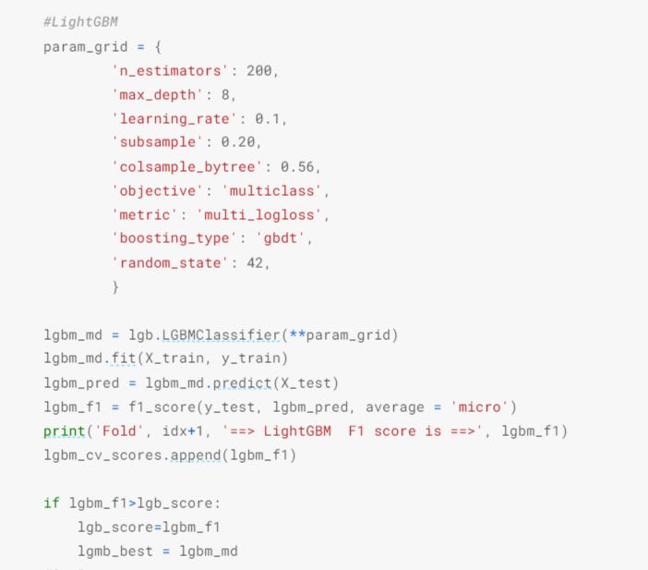
iv. Light Gradient Boosting Model
28

Slide 29
v. CatBoost Model
CatBoost is a powerful gradient-boosting technique, it uses a number of techniques to improve the accuracy and efficiency of gradient boosting, including feature engineering, decision tree optimization and a novel algorithm called ordered boosting.One of the main advantages of CatBoost is that it can handle categorical features without any feature encoding.
Used Parameters
loss_function = 'MultiClass': Specifies the loss function used for training. In this case, it's set for multi-class classification.
iterations : Determines the number of boosting iterations or trees to build during training.
learning_rate : Sets the step size or rate at which the model learns from the data.
depth : Specifies the maximum depth of each individual tree in the ensemble.
random_strength : Controls the magnitude of randomness for feature permutations during tree construction.
29

Slide 30
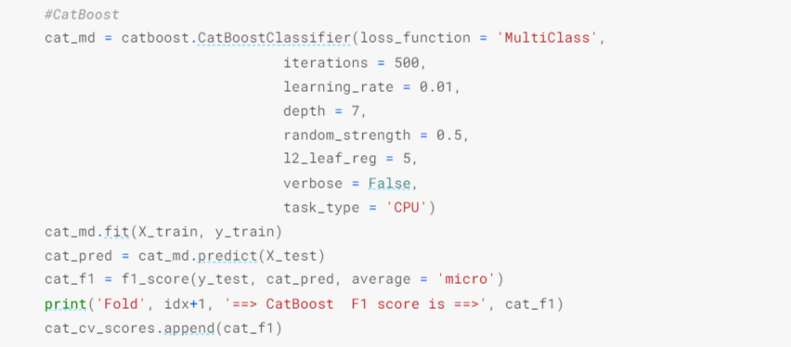
v. CatBoost Model
30

Slide 31
Comparison
Aspect | Decision Trees | Random Forest | XGBoost | LightGBM | CatBoost
Learning Approach | Builds a single tree with minimal impurity. | Ensemble of trees with bagging. | Sequentially builds trees correcting errors. | Gradient boosting with leaf-wise growth. | gradient boosting with a specialized handling of categorical features.
Handling of Data and Features | Not adept at handling missing data or categorical features without preprocessing. | Manages missing data by averaging across trees. Doesn't handle categorical features inherently. | Handles missing values internally, supports categorical features, and is robust with imbalanced data. | Handles missing values, supports categorical features, and uses exclusive feature bundling. | Efficiently handles categorical features without the need for one-hot encoding or label encoding.
Overfitting and Regularization | Prone to overfitting, especially with deeper or more complex trees. | Reduces overfitting compared to a single decision tree. | Implements regularization parameters. | Reduces overfitting with leaf-wise growth, potentially requiring fewer splits. | Has algorithm to prevent overfitting, including built-in support for depth-wise tree growth.
Computational Efficiency | Quick to build but may become computationally expensive with large datasets or complex structures. | Slower due to building multiple trees but provides better generalization. | Time-consuming, especially with large datasets, but offers high accuracy. | Faster due to leaf-wise growth, reducing computational cost, more efficient with large datasets. | Efficiently handles large datasets due to its handling of categorical features and optimization techniques.
31

Slide 32
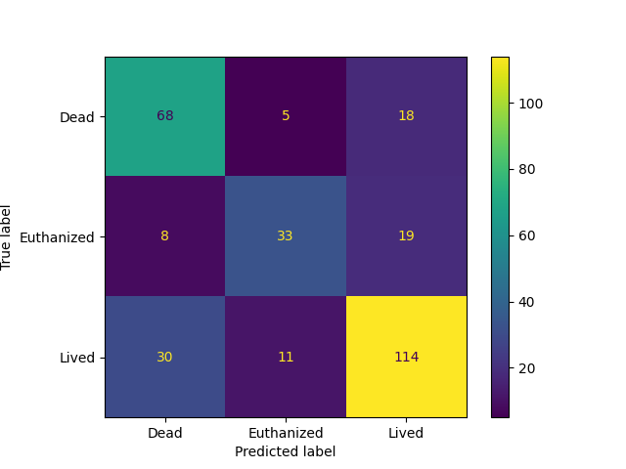
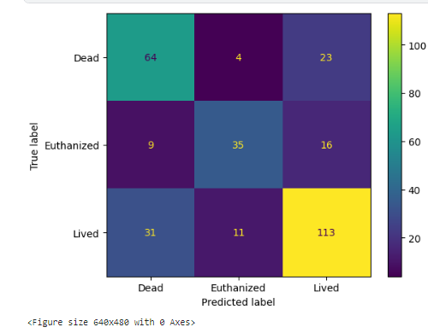
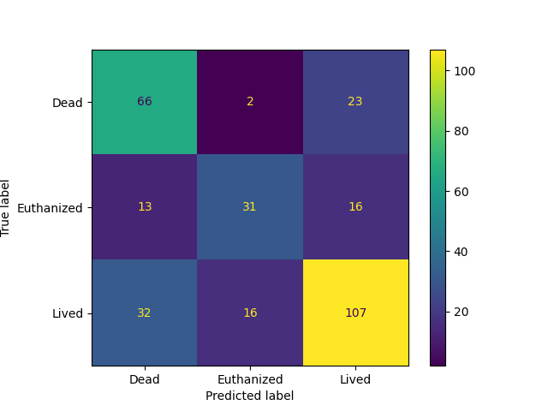
V
Evaluation
Model evaluation ensures the effectiveness and generalizability of the developed models. It involves assessing the performance of a model using various metrics and techniques to determine its ability to make accurate predictions on unseen data.
GIven Below are confusion Matrix of some of the boosted classifier we tested over the test set.
LightGBM
XGBoost
CatBoost
Confusion Matrix
32

Slide 33
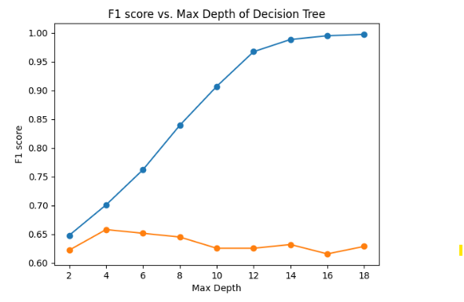
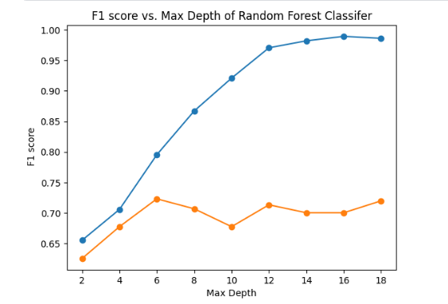
V
Evaluation
Each Model is evaluated with F1 score with the training dataset and to measure the optimal depth of the decision tree in the model we plot a graph to find a balance where F1 score is maximized without overfitting. Given are some of the graphs we plotted for the same reason.
33

Slide 34
VI
Results
Model | Fold 1 F1 Score | Fold 2 F1 Score | Fold 3 F1 Score | Fold 4 F1 Score | Fold 5 F1 Score
Decision Trees | 0.667 | 0.661 | 0.644 | 0.661 | 0.630
Random Forest | 0.697 | 0.690 | 0.693 | 0.680 | 0.679
XGBoost | 0.752 | 0.716 | 0.762 | 0.745 | 0.705
LightGBM | 0.758 | 0.729 | 0.765 | 0.739 | 0.692
CatBoost | 0.739 | 0.690 | 0.706 | 0.710 | 0.666
34

Slide 35
VI
Results
Average F1 Scores of all the models are assessed across 5-cross fold validation with parameter tuning.
Model | F1 Score
Decision Trees | 0.653
Random Forest | 0.688
XGBoost | 0.736
LightGBM | 0.737
CatBoost | 0.702
35

Slide 36
VI
Results
We can observe that Light GBM performed slightly better than Xgboost and Catboost, while Catboost and Xgboost performed almost similarly, and while decision tree performed worse.
We initially thought Catboost would give the best score because there were lots of categorical features and it uses target statistic ordered boosting but Lightgbm performed better. In all, we can say that gradient-boosted algorithms perform better than bagging and decision tree in this type of problem. Furthermore, the hyper-parameter tuning played a very important role here rather than feature selection. As tuning these parameters sufficiently increased f1 score.
In the competition on unseen test data, lgbm performed best giving 0.74696 F1 score in private score
while the best score was 0.82. It was only the top performers. Later it was in the 70s.
36

Slide 37
VII
Conclusion
In conclusion, in competitions with small datasets like this one, it seems more appropriate to find and apply precisely needed methods rather than engaging in extensive and complex data preprocessing and feature engineering to boost the CV Score.
In such competitions where collecting more data is not a feasible option, designing ensemble techniques to be more effective is necessary
VIII
Further Works
The current study demonstrates the potential of Optuna for hyperparameter optimization
Optuna is an open-source hyperparameter optimization framework for machine learning models. It's designed to make it easy for researchers and practitioners to find the best hyperparameters for their models in an efficient manner.
Also a more diverse external dataset which explores horses genetic factors and also influence of environmental factors such as climate, location, and access to veterinary care can also be beneficial to horse health and welfare as horses are generally susceptible to a variety of illnesses.
37

Slide 38

Kaggle Link
https://www.kaggle.com/code/nerdnightboy/horse-predictionv-v3-project
38

Slide 39
Refrences
N. S. Rajliwall, R. Davey and G. Chetty, "Cardiovascular Risk Prediction Based on XGBoost," 2018 5th Asia-Pacific World Congress on Computer Science and Engineering (APWC on CSE), Nadi, Fiji, 2018, pp. 246-252, doi: 10.1109/APWConCSE.2018.00047.
et. al., B. S. A. . (2021). Prediction of Type- 2 Diabetes using the LGBM Classifier Methods and Techniques. Turkish Journal of Computer and Mathematics Education (TURCOMAT), 12(12), 223–231.
M. S. Oughali, M. Bahloul and S. A. El Rahman, "Analysis of NBA Players and Shot Prediction Using Random Forest and XGBoost Models," 2019 International Conference on Computer and Information Sciences (ICCIS), Sakaka, Saudi Arabia, 2019, pp. 1-5, doi: 10.1109/ICCISci.2019.8716412.
Liu J, Wu J, Liu S, Li M, Hu K, Li K. Predicting mortality of patients with acute kidney injury in the ICU using XGBoost model. PLoS One. 2021 Feb 4;16(2):e0246306.
39

Slide 40
Refrences
Guolin Ke, Qi Meng, Thomas Finley, Taifeng Wang, Wei Chen, Weidong Ma, Qiwei Ye, and Tie-Yan Liu. 2017. LightGBM: a highly efficient gradient boosting decision tree. In Proceedings of the 31st International Conference on Neural Information Processing Systems (NIPS'17). Curran Associates Inc., Red Hook, NY, USA, 3149–3157.
Tianqi Chen and Carlos Guestrin. 2016. XGBoost: A Scalable Tree Boosting System. In Proceedings of the 22nd ACM SIGKDD International Conference on Knowledge Discovery and Data Mining (KDD '16). Association for Computing Machinery, New York, NY, USA, 785–794. https://doi.org/10.1145/2939672.2939785
Liudmila Prokhorenkova, Gleb Gusev, Aleksandr Vorobev, Anna Veronika Dorogush, and Andrey Gulin. 2018. CatBoost: unbiased boosting with categorical features. In Proceedings of the 32nd International Conference on Neural Information Processing Systems (NIPS'18). Curran Associates Inc., Red Hook, NY, USA, 6639–6649.
40

Slide 41
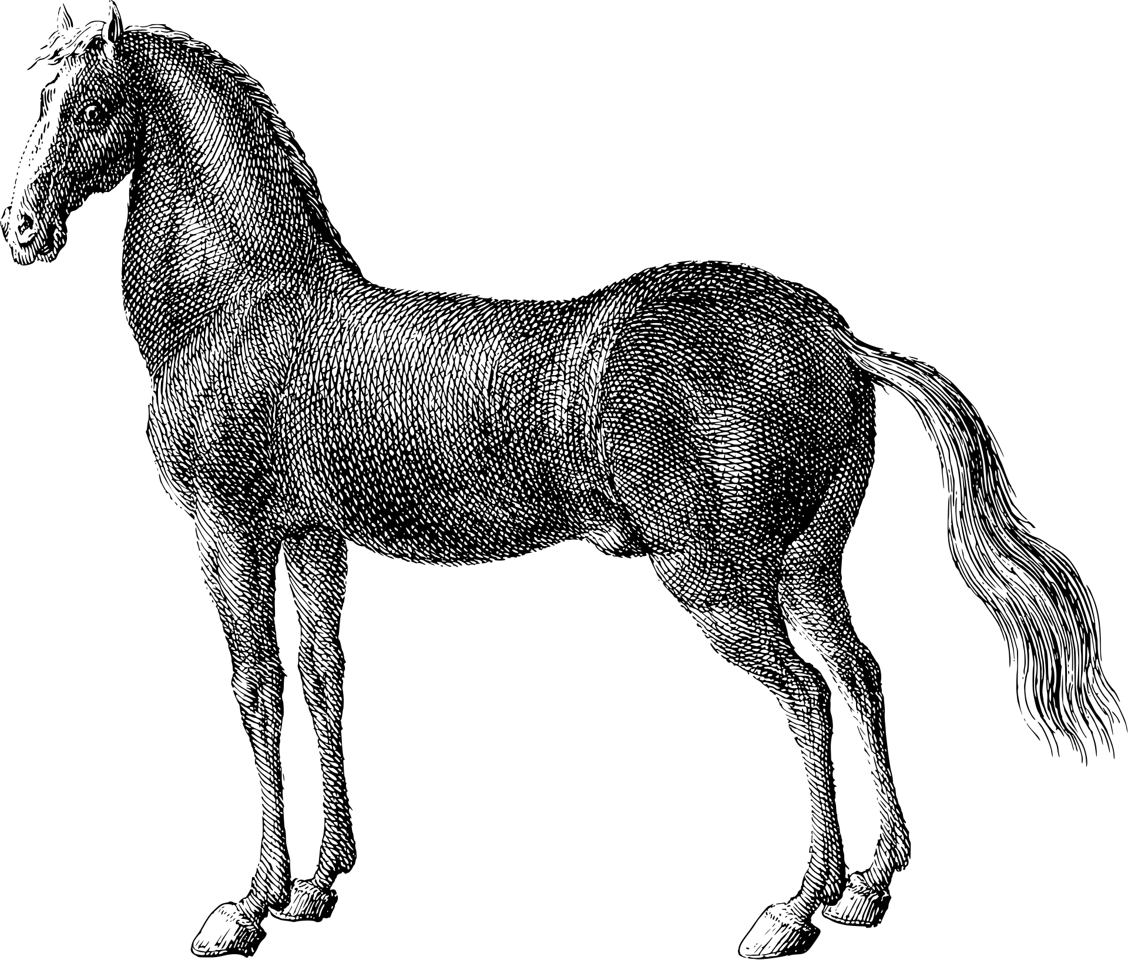
26/11/2023
ADVISOR
STUDENT
Aman Gaur(10)
Sagar Rathore(49)
Satyam Sahu(51)
Department of Computer Science, University of Delhi
Dr. Bharti
Thank you
for listening!

